Slide 1



Bus Depots Deploy Mgmt System(C#)
Schedule Management Web Service (PHP)
Train Management System (Java)
Twitter Plugin
Get nearest Bus Depot Web Service (Java)
Bus Depot JMS Address
Weather API

Slide 2

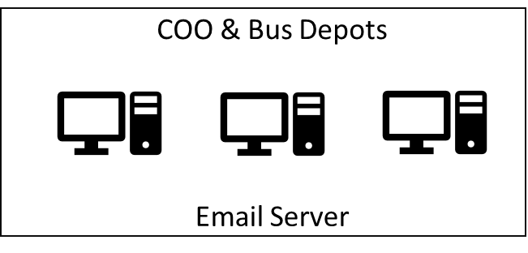







t.weather
t.ns.listener
t.ew.listener
Train Mgmt Messaging System
Break down messages
Heavy Rainfall Report
Train Listeners
Twitter Plugin
t.weather
t.<dynamic>.listener
Send Emails
breakdown.xml (new_breakdown.xsd)
TIBCO BW
EMS
q.breakdown
q.deployed
q.depot.<dynamic>
t.weather
t.<dynamic>.listener
P q.breakdown (Q)
P q.deployed
C q.deployed (Q)
File Poller
busRequest.xml (new_busRequest.xsd)
Bus Management System
C q.depot.<dynamic>
HTTP
HTTP
q.depot.jurong
q.depot.tampines
q.depot.toapayoh
Get nearest Bus Depot
Web Service
HTTP
Schedule Management
Web Service (PHP)
Weather API
(wrapped NEA Api w code)
Bus Depots Deploy Mgmt System

